Slide 1
Data Preparation and Analysis Module 5

Slide 2
Linear Regression
Mr. Ming-Long Lam Ph.D. in Statistics

Slide 3
Module 5 Lesson Plan
Lesson 1: Linear Regression Model
Understand the Concept of Least Squares Algorithm
Understand the Concepts of Intrinsic and Extrinsic Aliasing.
Understand the SWEEP Operator.
Lesson 2: Forward Selection
Understand the Concept of Nested Models and the F Test.
Use the Forward Selection Method to Build the Model.
Lesson 3: Feature Importance
Interpret Parameter Estimates.
Calculate the Shapley Values to Measure Importance.

Slide 4
END OF INTRODUCTION

Slide 5
Lesson 1: Linear Regression Model

Slide 6
Theory and Methodology

Slide 7
A Multiple Linear Regression Model
$n$: number of observations, $p$: number of numeric features
𝑛: number of observations, 𝑝: number of numeric features
$y_{i}=\sum_{j=0}^{p}{x_{ij}b_{j}}+ε_{i}$, $i=1,…,n$ ($x_{i0}=1$ for the Intercept term)
𝑦_𝑖=∑_(𝑗=0)^𝑝▒〖𝑥_𝑖𝑗 𝑏_𝑗 〗+𝜀_𝑖, 𝑖=1,…,𝑛 (𝑥_𝑖0=1 for the Intercept term)
$ε_{i}$, $i=1,…,n$ are independent and identically distributed as $N\left(0,σ^{2}\right)$
𝜀_𝑖, 𝑖=1,…,𝑛 are independent and identically distributed as 𝑁(0,𝜎^2 )

Slide 8
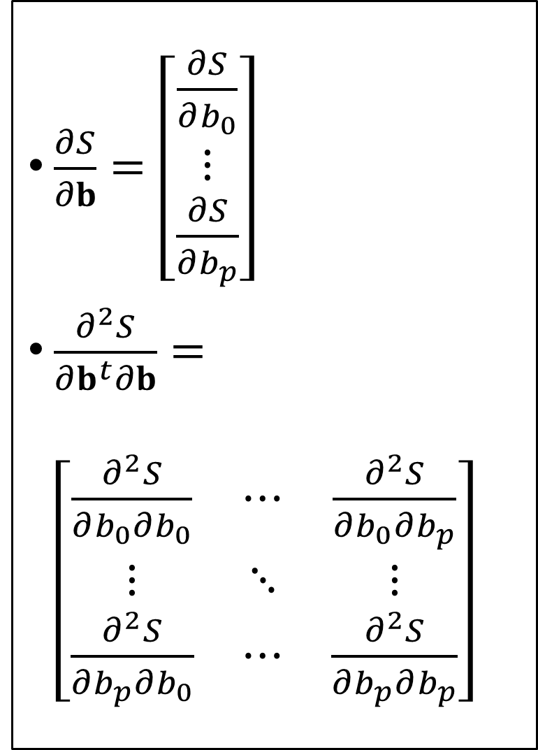
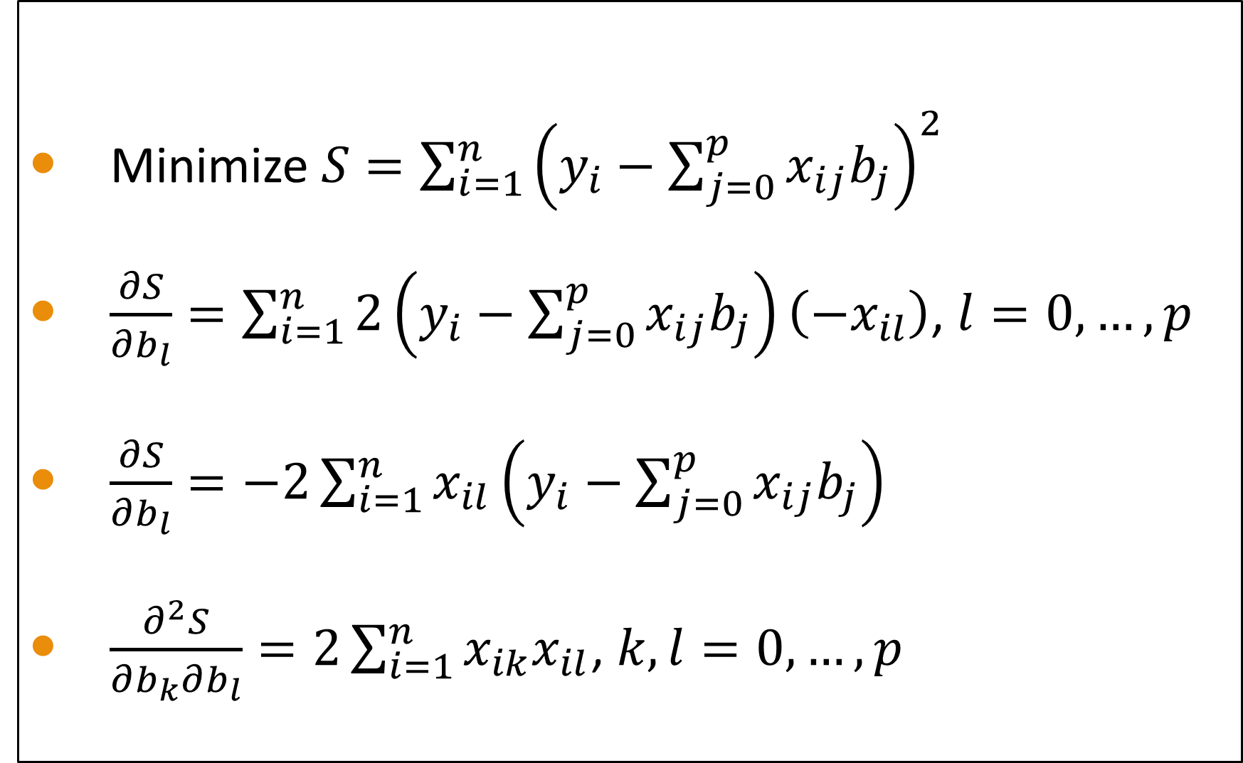
Ordinary Least Squares Estimation
Minimize $S=\sum_{i=1}^{n}{{\left(y_{i}−\sum_{j=0}^{p}{x_{ij}b_{j}}\right)}^{2}}$
$\frac{∂S}{∂b_{l}}=\sum_{i=1}^{n}{2\left(y_{i}−\sum_{j=0}^{p}{x_{ij}b_{j}}\right)\left(−x_{il}\right)}$, $l=0,…,p$
$\frac{∂S}{∂b_{l}}=−2\sum_{i=1}^{n}{x_{il}\left(y_{i}−\sum_{j=0}^{p}{x_{ij}b_{j}}\right)}$
$\frac{∂^{2}S}{∂b_{k}∂b_{l}}=2\sum_{i=1}^{n}{x_{ik}x_{il}}$, $k,l=0,…,p$
$\frac{∂S}{∂b}=\left[\begin{matrix}\frac{∂S}{∂b_{0}} \\ ⋮ \\ \frac{∂S}{∂b_{p}}\end{matrix}\right]$
$\frac{∂^{2}S}{∂b^{t}∂b}=\left[\begin{matrix}\frac{∂^{2}S}{∂b_{0}∂b_{0}} & ⋯ & \frac{∂^{2}S}{∂b_{0}∂b_{p}} \\ ⋮ & ⋱ & ⋮ \\ \frac{∂^{2}S}{∂b_{p}∂b_{0}} & ⋯ & \frac{∂^{2}S}{∂b_{p}∂b_{p}}\end{matrix}\right]$

Slide 9
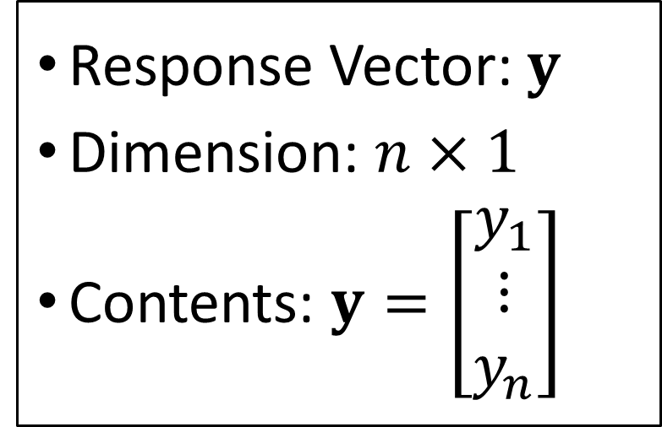
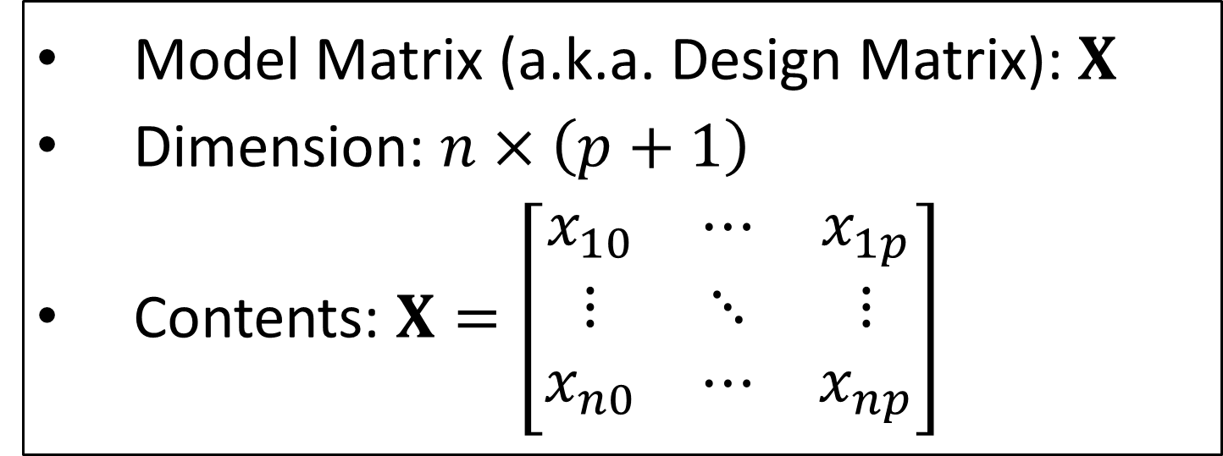
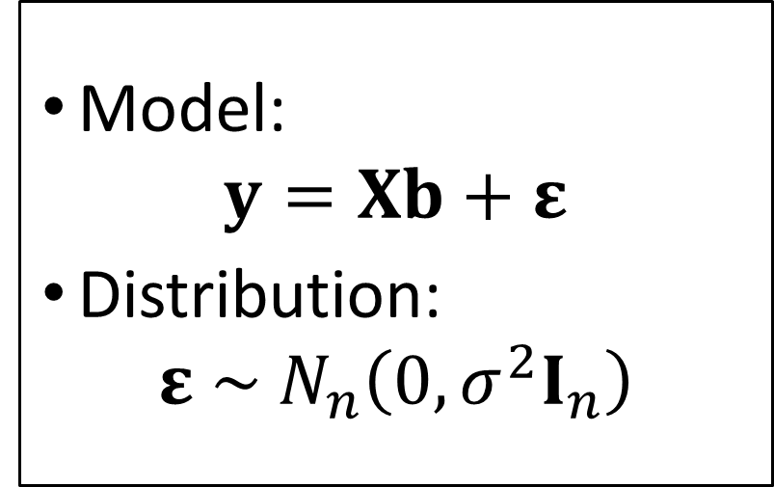
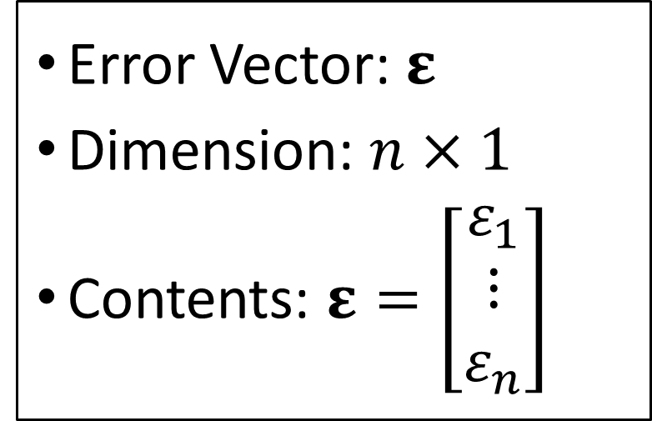
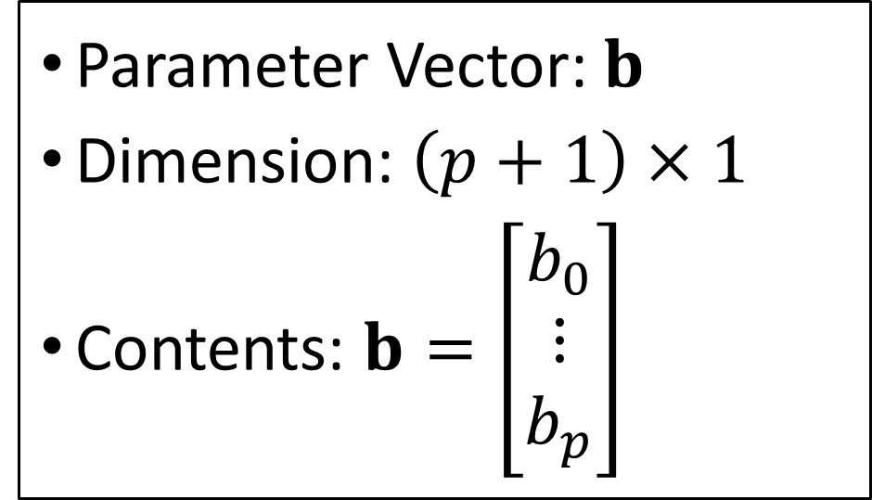
A Linear Regression Model in Matrix Form
Model Matrix (a.k.a. Design Matrix): $X$
Dimension: $n×\left(p+1\right)$
Contents: $X=\left[\begin{matrix}x_{10} & ⋯ & x_{1p} \\ ⋮ & ⋱ & ⋮ \\ x_{n0} & ⋯ & x_{np}\end{matrix}\right]$
Parameter Vector: $b$
Dimension: $\left(p+1\right)×1$
Contents: $b=\left[\begin{matrix}b_{0} \\ ⋮ \\ b_{p}\end{matrix}\right]$
Response Vector: $y$
Dimension: $n×1$
Contents: $y=\left[\begin{matrix}y_{1} \\ ⋮ \\ y_{n}\end{matrix}\right]$
Error Vector: $ε$
Dimension: $n×1$
Contents: $ε=\left[\begin{matrix}ε_{1} \\ ⋮ \\ ε_{n}\end{matrix}\right]$
Model:
$$y=Xb+ε$$
Distribution:
$$ε \sim N_{n}\left(0,σ^{2}I_{n}\right)$$

Slide 10
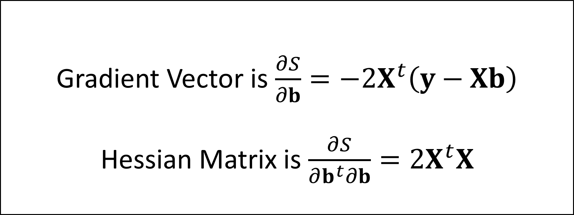
The Derivatives in Matrix Forms
Gradient Vector is $\frac{∂S}{∂b}=−2X^{t}\left(y−Xb\right)$
Hessian Matrix is $\frac{∂S}{∂b^{t}∂b}=2X^{t}X$
Prove-It-Yourself Hint: Write out the elements of the matrix/vector products.

Slide 11
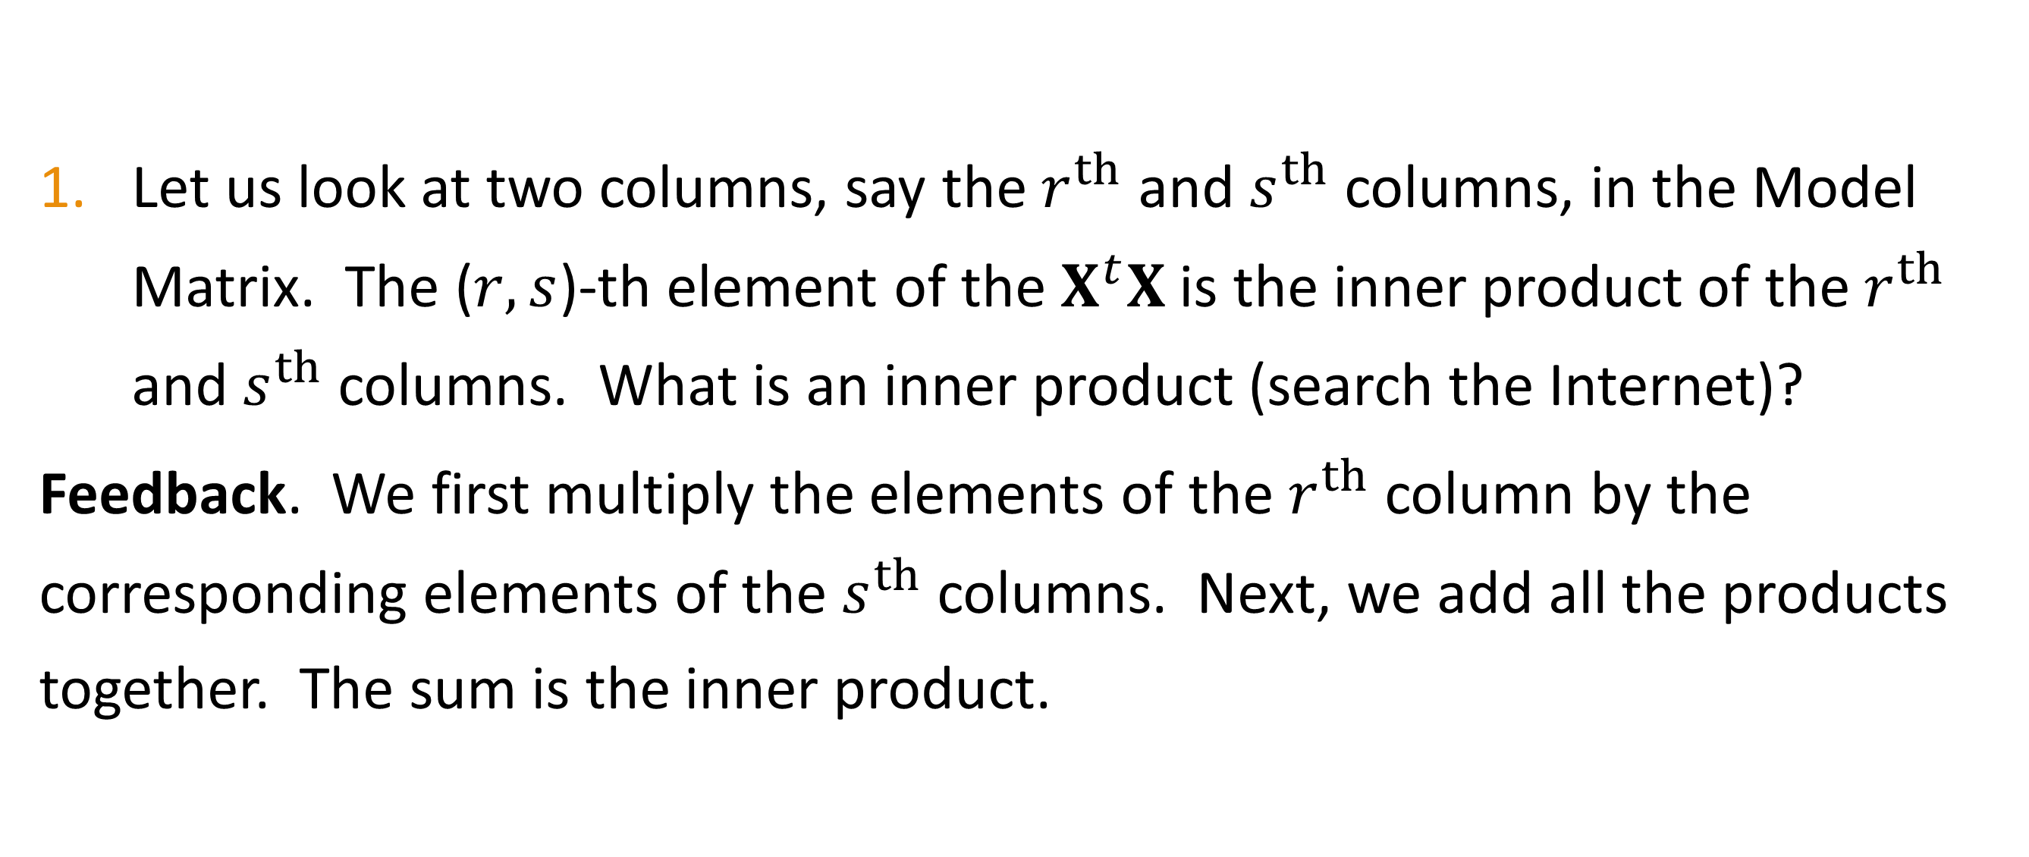
=== In-Video Questions For Slide 10 ===
Let us look at two columns, say the $r^{th}$ and $s^{th}$ columns, in the Model Matrix. The ($r,s$)-th element of the $X^{t}X$ is the inner product of the $r^{th}$ and $s^{th}$ columns. What is an inner product (search the Internet)?
Feedback. We first multiply the elements of the $r^{th}$ column by the corresponding elements of the $s^{th}$ columns. Next, we add all the products together. The sum is the inner product.

Slide 12
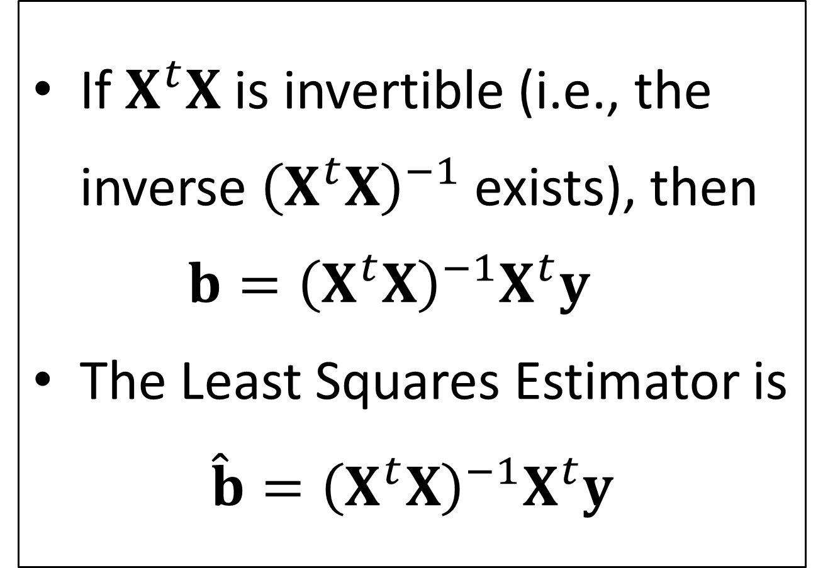
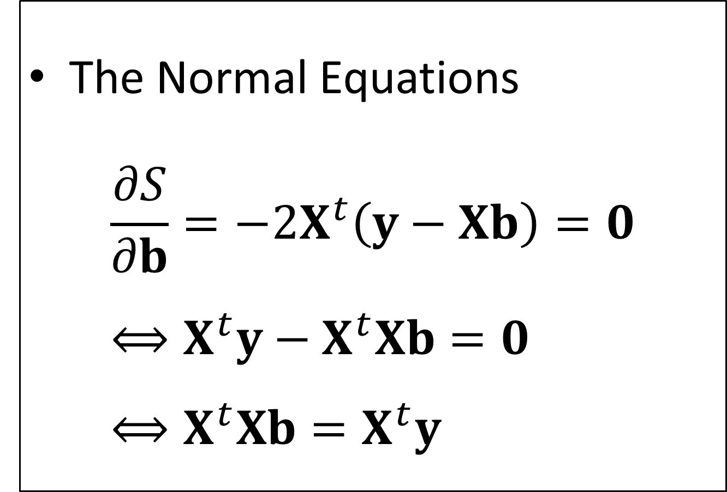
The Least Squares Estimator
The Normal Equations
$$\frac{∂S}{∂b}=−2X^{t}\left(y−Xb\right)=0 \\ ⟺X^{t}y−X^{t}Xb=0 \\ ⟺X^{t}Xb=X^{t}y$$
If $X^{t}X$ is invertible (i.e., the inverse ${\left(X^{t}X\right)}^{−1}$ exists), then $b={\left(X^{t}X\right)}^{−1}X^{t}y$
The Least Squares Estimator is
$$\hat{b}={\left(X^{t}X\right)}^{−1}X^{t}y$$

Slide 13
The Least Square Estimator
This estimator is the Best Linear Unbiased Estimator (BLUE).
Linear. This estimator is a linear combination of the observed response values.
Best. This estimator has the highest precision (i.e., lowest variance) among all other linear estimators.
Unbiased. This estimator will not, in theory, over- or under-estimate the population regression parameters.

Slide 14
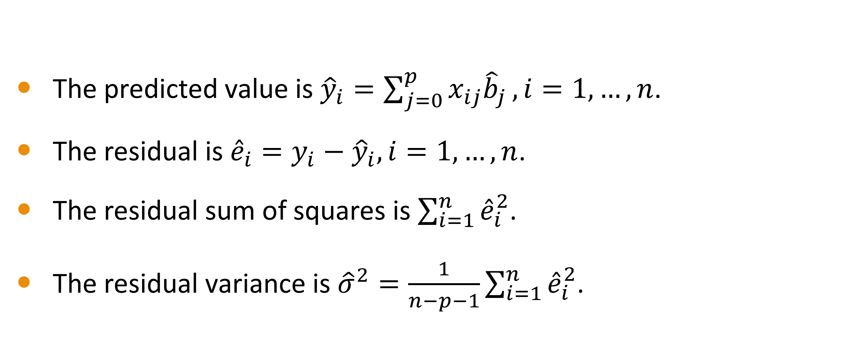
Predicted Values and Residuals
The predicted value is ${\hat{y}}_{i}=\sum_{j=0}^{p}{x_{ij}{\hat{b}}_{j}},i=1,…,n$.
The residual is ${\hat{e}}_{i}=y_{i}−{\hat{y}}_{i},i=1,…,n$.
The residual sum of squares is $\sum_{i=1}^{n}{{\hat{e}}_{i}^{2}}$.
The residual variance is ${\hat{σ}}^{2}=\frac{1}{n−p−1}\sum_{i=1}^{n}{{\hat{e}}_{i}^{2}}$.

Slide 15
Identify Aliased Parameters

Slide 16
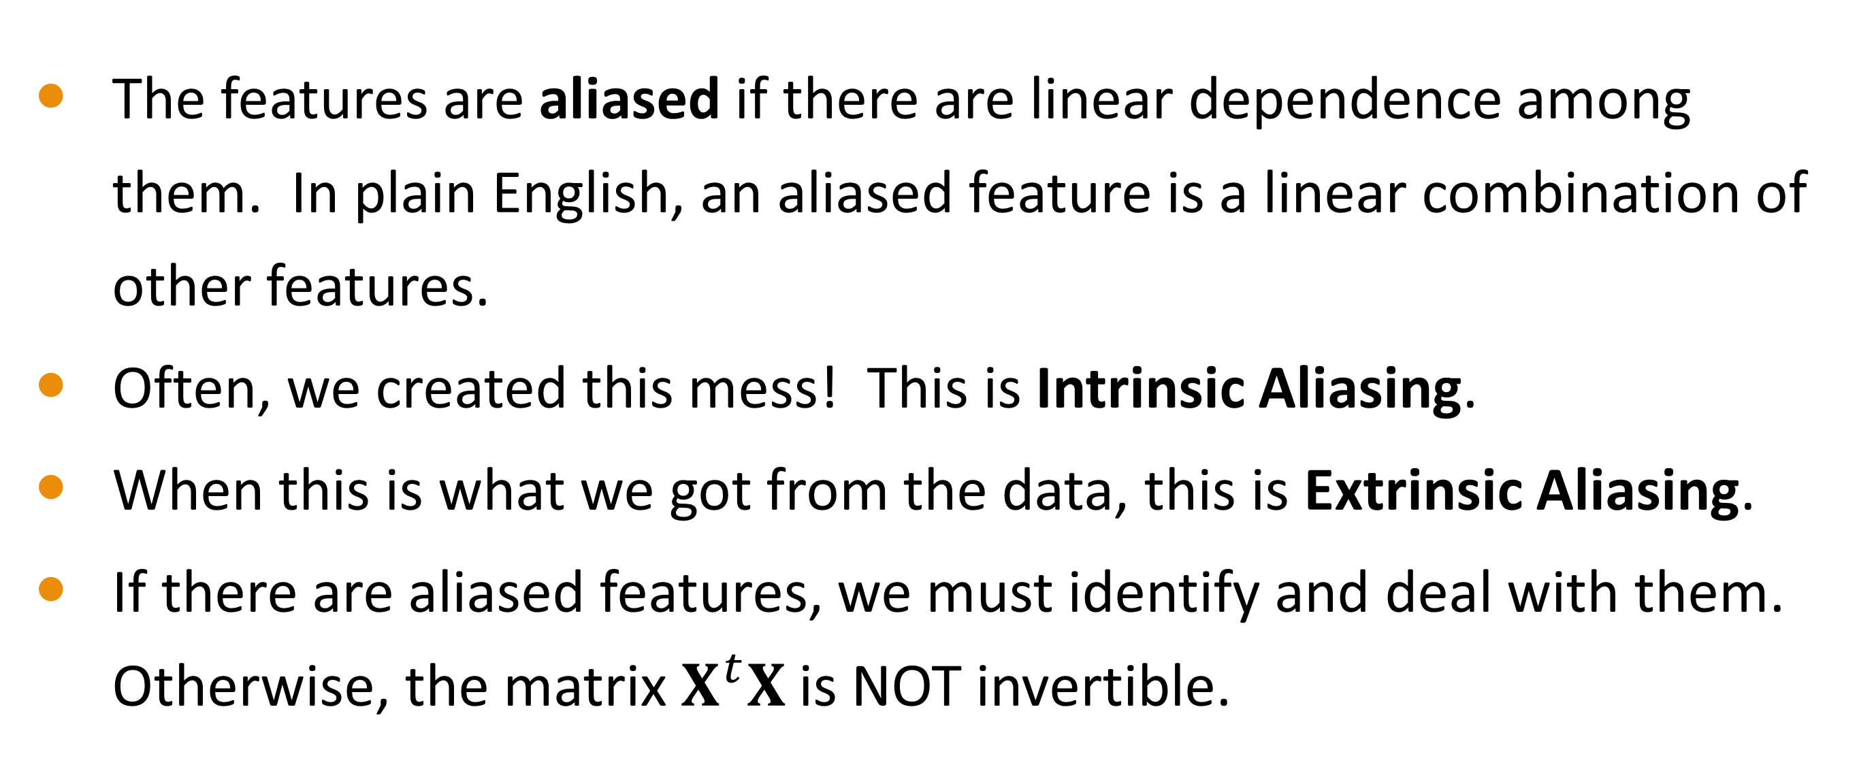
Aliasing
The features are aliased if there are linear dependence among them. In plain English, an aliased feature is a linear combination of other features.
Often, we created this mess! This is Intrinsic Aliasing.
When this is what we got from the data, this is Extrinsic Aliasing.
If there are aliased features, we must identify and deal with them. Otherwise, the matrix $X^{t}X$ is NOT invertible.

Slide 17
The SWEEP Operator
James H. Goodnight (1979), “A Tutorial on the SWEEP Operator”, The American Statistician , Volume 33, Number 2, pages 149 – 158. https://doi-org.proxy.uchicago.edu/10.2307/2683825
Clarke, Michael R. B. (1982), “Algorithm AS 178: The Gauss-Jordan Sweep Operator with Detection of Collinearity”, Journal of the Royal Statistical Society. Series C (Applied Statistics), Volume 31, Number 2, Pages 166 – 168. https://doi-org.proxy.uchicago.edu/10.2307/2347983

Slide 18
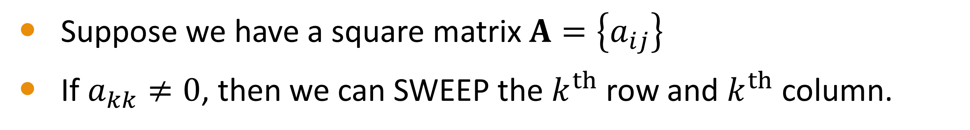
The SWEEP Operator
Suppose we have a square matrix $A=\left\{a_{ij}\right\}$
If $a_{kk}≠0$, then we can SWEEP the $k^{th}$ row and $k^{th}$ column.
Step 1: $a_{ij}←a_{ij}−{a_{ik}a_{kj}}/{a_{kk}}$ for $i≠k$ and $j≠k$
Step 1: 𝑎_𝑖𝑗←𝑎_𝑖𝑗−〖𝑎_𝑖𝑘 𝑎_𝑘𝑗〗∕𝑎_𝑘𝑘 for 𝑖≠𝑘 and 𝑗≠𝑘
Step 2: $a_{ik}←{a_{ik}}/{\left|a_{kk}\right|}$ for $i≠k$
Step 2: 𝑎_𝑖𝑘←𝑎_𝑖𝑘∕|𝑎_𝑘𝑘 | for 𝑖≠𝑘
Step 3: $a_{kj}←{a_{kj}}/{\left|a_{kk}\right|}$ for $j≠k$
Step 3: 𝑎_𝑘𝑗←𝑎_𝑘𝑗∕|𝑎_𝑘𝑘 | for 𝑗≠𝑘
Step 4: $a_{kk}←−1/{a_{kk}}$
Step 4: 𝑎_𝑘𝑘←−1∕𝑎_𝑘𝑘

Slide 19
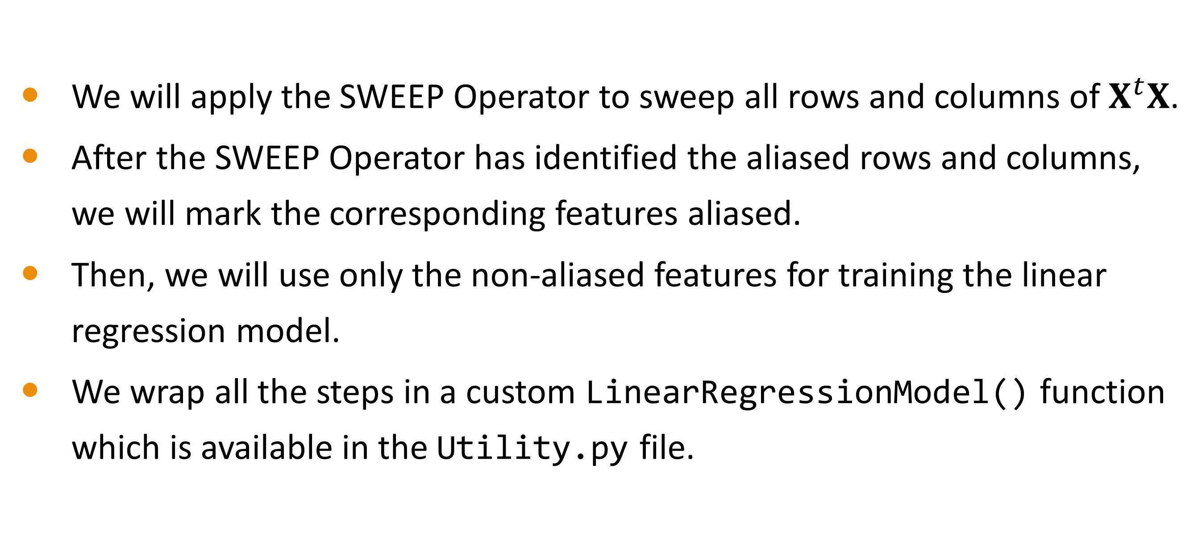
Apply The SWEEP Operator
We will apply the SWEEP Operator to sweep all rows and columns of $X^{t}X$.
After the SWEEP Operator has identified the aliased rows and columns, we will mark the corresponding features aliased.
Then, we will use only the non-aliased features for training the linear regression model.
We wrap all the steps in a custom LinearRegressionModel() function which is available in the Utility.py file.

Slide 20
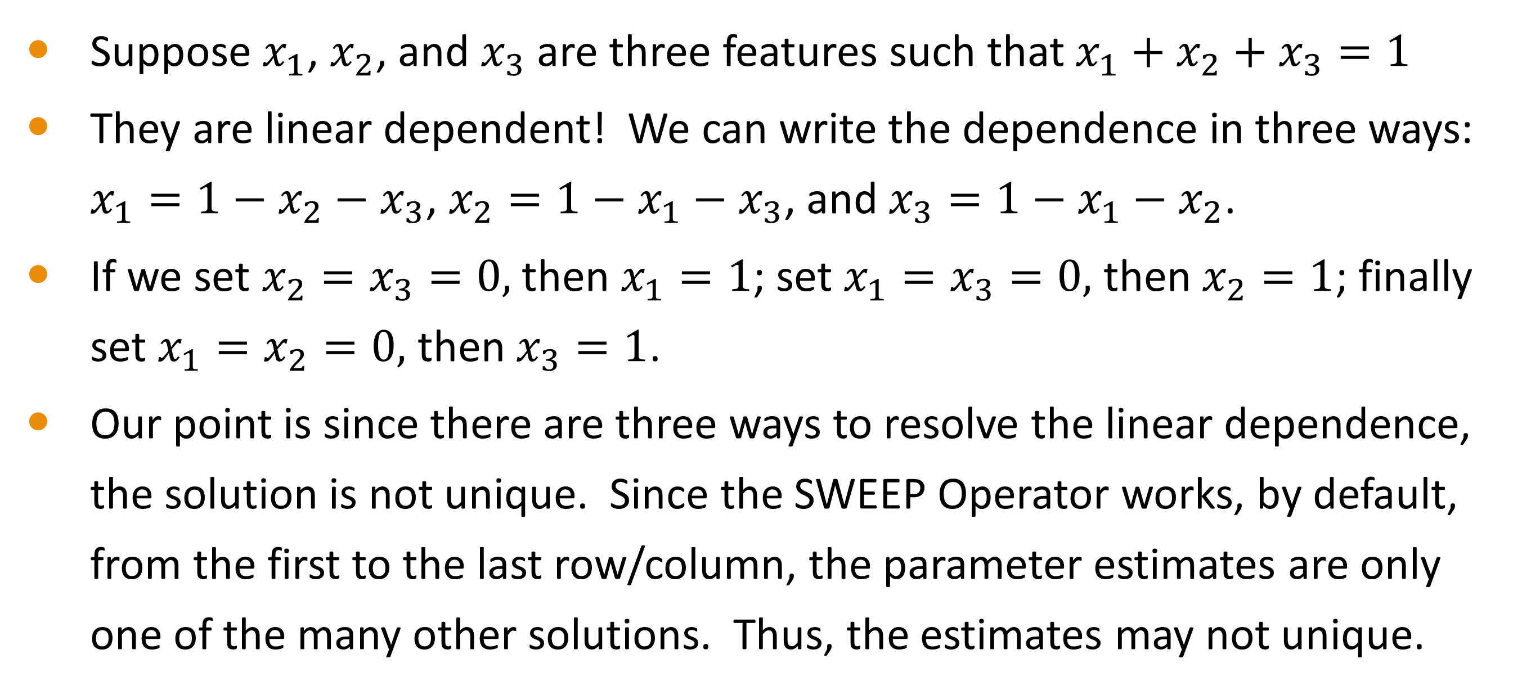
The Side Effect of SWEEP
Suppose $x_{1}$, $x_{2}$, and $x_{3}$ are three features such that $x_{1}+x_{2}+x_{3}=1$
They are linear dependent! We can write the dependence in three ways: $x_{1}=1−x_{2}−x_{3}$, $x_{2}=1−x_{1}−x_{3}$, and $x_{3}=1−x_{1}−x_{2}$.
If we set $x_{2}=x_{3}=0,$ then $x_{1}=1$; set $x_{1}=x_{3}=0,$ then $x_{2}=1$; finally set $x_{1}=x_{2}=0,$ then $x_{3}=1$.
Our point is since there are three ways to resolve the linear dependence, the solution is not unique. Since the SWEEP Operator works, by default, from the first to the last row/column, the parameter estimates are only one of the many other solutions. Thus, the estimates may not unique.

Slide 21
Despite The Side Effect of SWEEP …
The predicted response value is unique.
In plain English, the predicted response value stays the same regardless of which parameters in the model are found aliased.
Also, the parameter estimates are unique IF there are no aliased parameters (i.e., all columns of the model matrix are linearly independent).

Slide 22
Let Us Take a Taxi in Chicago

Slide 23
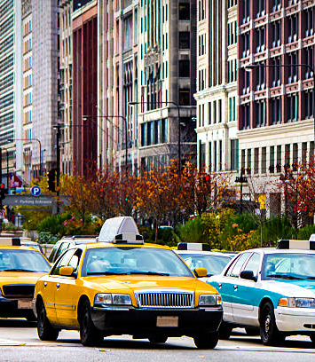
Chicago Taxi Trip Data
Source: City of Chicago Data Portal (https://data.cityofchicago.org)
Twenty taxi trips from Chicago Loop to either Midway or O’Hare Airport
Trips were made in the evenings in January 2016
Trip_Minutes: Elapsed time in minutes
Trip_Miles: Number of miles traveled
Payment_Method: Cash or Credit Card
Trip_Payment: Total payment (fare, surcharge, and tip) received

Slide 24
Twenty Chicago Taxi Trips
Trip_ID | Trip_Start_Date | Trip_Start_Time | Pickup_Area | Dropoff_Area | Trip_Minutes | Trip_Miles | Payment_Method | Trip_Payment
1 | 1/2/2016 | 4:15:00 PM | Loop | Airport | 28 | 11 | Cash | 29.75
2 | 1/2/2016 | 4:15:00 PM | Loop | Airport | 34 | 17.8 | Cash | 44.75
3 | 1/6/2016 | 6:15:00 PM | Loop | Airport | 28 | 17.5 | Credit Card | 52.80
4 | 1/8/2016 | 4:30:00 PM | Loop | Airport | 45 | 17.4 | Credit Card | 51.90
5 | 1/8/2016 | 6:30:00 PM | Loop | Airport | 33 | 18.6 | Credit Card | 51.50
6 | 1/11/2016 | 4:15:00 PM | Loop | Airport | 38 | 18.1 | Cash | 44.75
7 | 1/12/2016 | 4:15:00 PM | Loop | Airport | 39 | 18.1 | Credit Card | 54.00
8 | 1/13/2016 | 4:30:00 PM | Loop | Airport | 39 | 17.6 | Credit Card | 53.50
9 | 1/15/2016 | 4:15:00 PM | Loop | Airport | 54 | 17.4 | Cash | 43.75
10 | 1/15/2016 | 4:30:00 PM | Loop | Airport | 37 | 11.6 | Cash | 31.25
11 | 1/15/2016 | 4:30:00 PM | Loop | Airport | 51 | 18.5 | Cash | 46.50
12 | 1/18/2016 | 5:15:00 PM | Loop | Airport | 44 | 18.72 | Cash | 47.00
13 | 1/18/2016 | 5:15:00 PM | Loop | Airport | 35 | 17.9 | Credit Card | 52.50
14 | 1/18/2016 | 6:30:00 PM | Loop | Airport | 24 | 17.2 | Cash | 42.75
15 | 1/20/2016 | 4:15:00 PM | Loop | Airport | 38 | 18.3 | Credit Card | 50.75
16 | 1/20/2016 | 8:15:00 PM | Loop | Airport | 24 | 12.4 | Credit Card | 39.60
27 | 1/20/2016 | 10:45:00 PM | Loop | Airport | 32 | 20.2 | Cash | 50.50
18 | 1/21/2016 | 4:15:00 PM | Loop | Airport | 46 | 11 | Credit Card | 38.75
19 | 1/21/2016 | 5:00:00 PM | Loop | Airport | 52 | 17.3 | Credit Card | 53.40
20 | 1/21/2016 | 8:30:00 PM | Loop | Airport | 25 | 12.9 | Cash | 32.75

Slide 25
Understand The Data
O’Hare
Midway

Slide 26
=== In-Video Questions For Slide 25 ===
Does the scatterplot of Trip Payment vs. Trip Number of Minutes exhibit any linear relationship?
Can you think of any reasons for the lack of linear relationship?
Suggestions. In our opinion, there is no apparent relationship. The fare for one mile travelled is equivalent to that of 6.75 minutes elapsed. Unless a taxi stops en route to the destination per passengers’ request or due to traffic situation, the elapsed time usually does not affect the fare much. Check out Chicago Taxi Placard 2020 for taxi fare schedule in Chicago.

Slide 27
Twenty Chicago Taxi Trips
Module 5 Twenty Chicago Taxi Trip.py

Slide 28
First Linear Regression Model
Parameter | Estimate | Standard Error | t | Significance | 95% Confidence Interval | Upper 95 CI
 |  |  |  |  | Lower Limit | Upper Limit
Intercept | 6.6456 | 6.4411 | 1.0318 | 0.3166 | -6.9438 | 20.2350
Trip_Minutes | 0.0834 | 0.1138 | 0.7333 | 0.4734 | -0.1566 | 0.3235
Trip_Miles | 2.1768 | 0.3629 | 5.9980 | 1.4396E-05 | 1.4111 | 2.9425
Predicted Trip_Payment = 6.6456 + 0.0834 × Trip_Minutes + 2.1768 × Trip_Miles.
The Intercept value of 6.6456 indicates that a passenger is charged a base fare (a.k.a. flag pull) of $6.6456 at the beginning of each trip.
The fare structure is $2.1768 per mile and 8.34 cents per minute.

Slide 29
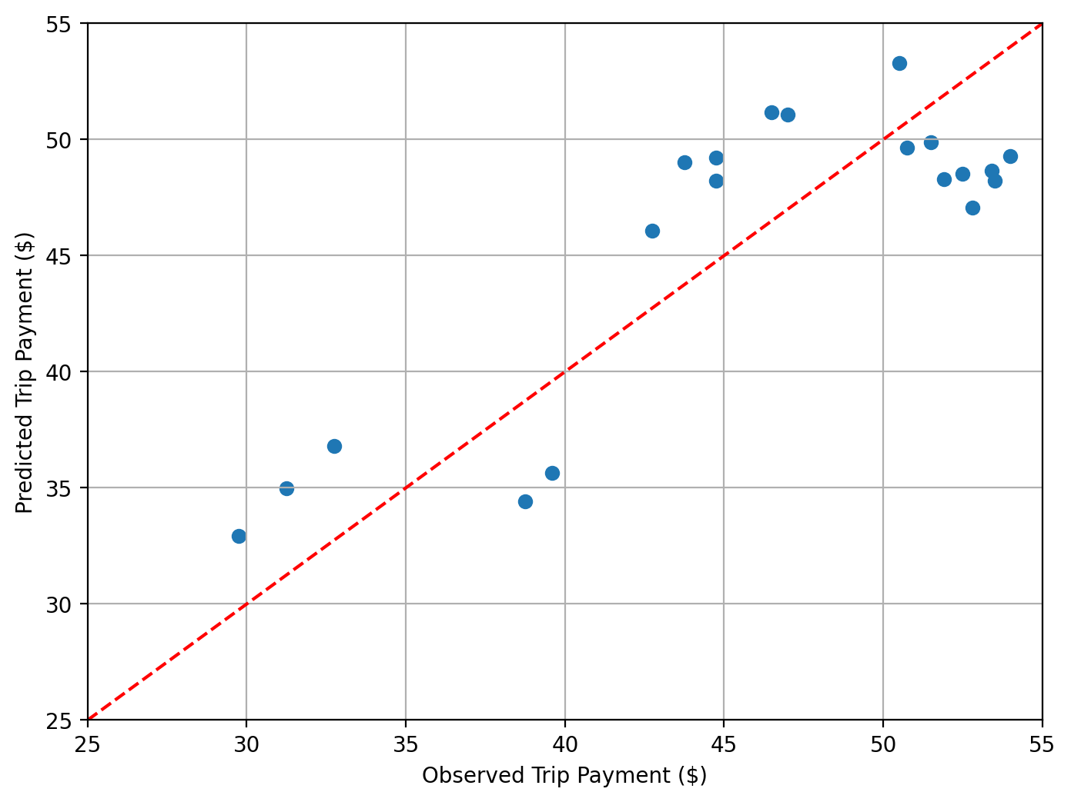
Predicted Versus Observed Response
The red dotted line is a 45-degree reference line.
Markers above (below) the reference line indicate over-(under-) estimated Trip Payment.

Slide 30
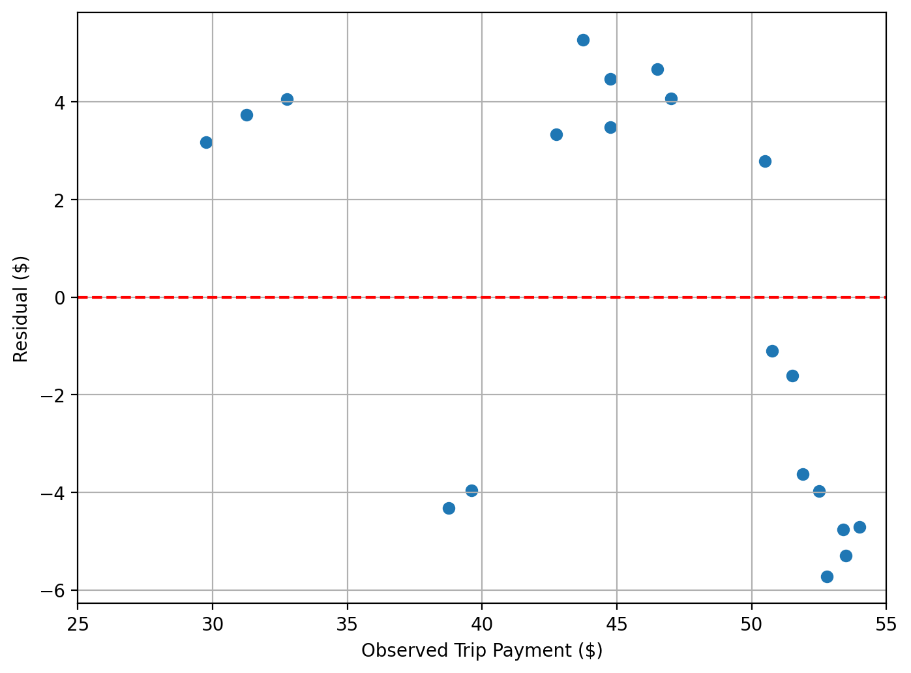
Residual Versus Observed Response
This chart should be uneventful. However, we do not think this is the case here.
We need more features!
On another hand, the 95% confidence interval for Trip_Minutes covers the value zero. Do we need this feature?

Slide 31
END OF LESSON 1

Slide 32
Lesson 2: Forward Selection

Slide 33
Nested Models

Slide 34

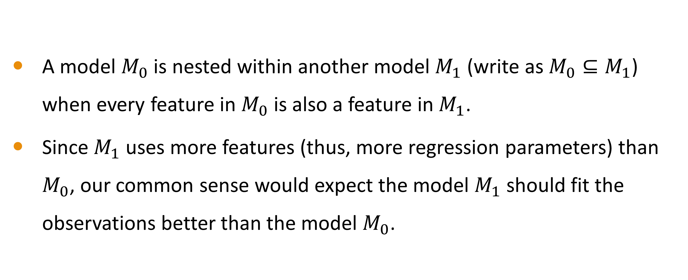
Nested Models
A model $M_{0}$ is nested within another model $M_{1}$ (write as $M_{0}⊆M_{1}$) when every feature in $M_{0}$ is also a feature in $M_{1}$.
Since $M_{1}$ uses more features (thus, more regression parameters) than $M_{0}$, our common sense would expect the model $M_{1}$ should fit the observations better than the model $M_{0}$.

Slide 35
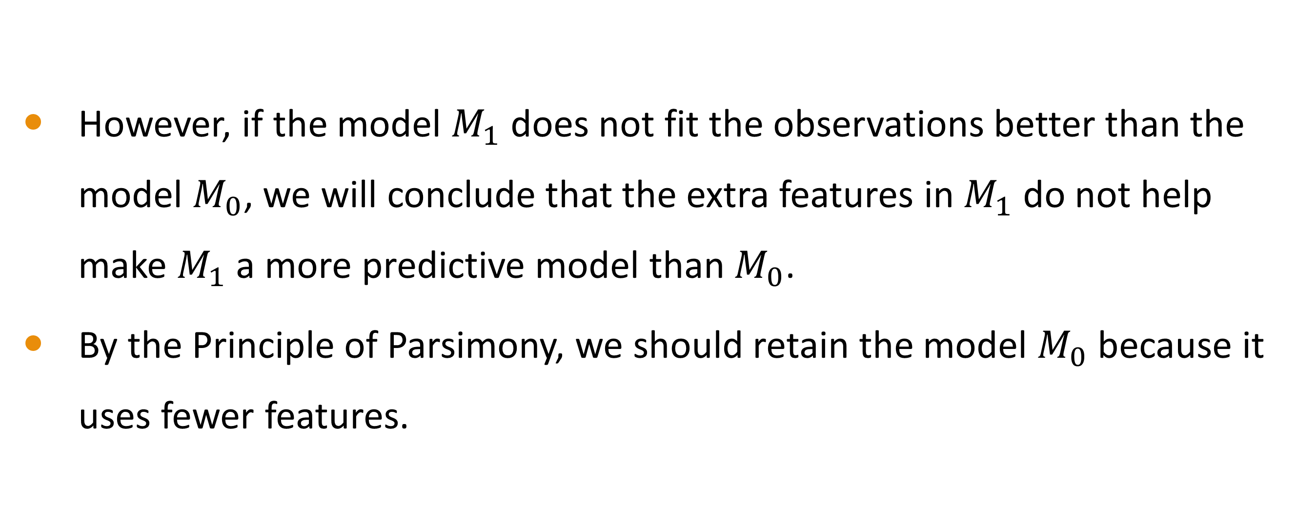
Nested Models
However, if the model $M_{1}$ does not fit the observations better than the model $M_{0}$, we will conclude that the extra features in $M_{1}$ do not help make $M_{1}$ a more predictive model than $M_{0}$.
By the Principle of Parsimony, we should retain the model $M_{0}$ because it uses fewer features.

Slide 36

Is Model $M_{0}$ Nested Within Model $M_{1}$?
$M_{0}$ : Intercept
$M_{1}$ : Intercept + Trip_Minutes
𝑀_0 : Intercept
𝑀_1 : Intercept + Trip_Minutes
$M_{0}$ : Intercept+ Trip_Minutes
$M_{1}$ : Intercept + Trip_Minutes + Trip_Miles
𝑀_0 : Intercept+ Trip_Minutes
𝑀_1 : Intercept + Trip_Minutes + Trip_Miles
$M_{0}$ : Intercept + Trip_Minutes + Trip_Miles
$M_{1}$ : Intercept + Trip_Minutes + Trip_Miles + Trip_Minutes * Trip_Minutes
𝑀_0 : Intercept + Trip_Minutes + Trip_Miles
𝑀_1 : Intercept + Trip_Minutes + Trip_Miles + Trip_Minutes * Trip_Minutes
$M_{0}$ : Intercept + Trip_Minutes
$M_{1}$ : Intercept + Trip_Minutes * Trip_Minutes
𝑀_0 : Intercept + Trip_Minutes
𝑀_1 : Intercept + Trip_Minutes * Trip_Minutes
$M_{0}$ : Intercept+ Trip_Minutes
$M_{1}$ : Intercept + Trip_Miles
𝑀_0 : Intercept+ Trip_Minutes
𝑀_1 : Intercept + Trip_Miles
$M_{0}$ : Intercept
$M_{1}$ : Trip_Minutes
𝑀_0 : Intercept
𝑀_1 : Trip_Minutes
I
II
III
IV
V
VI

Slide 37
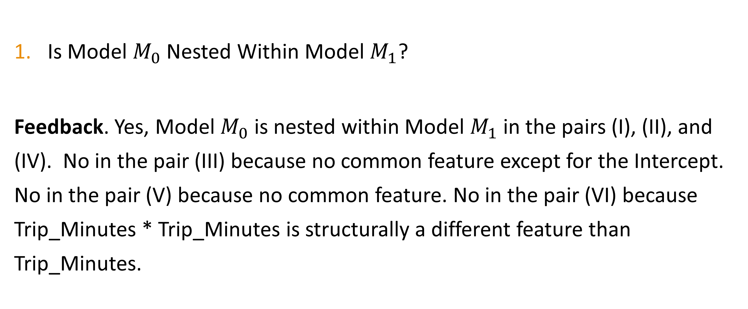
=== In-Video Questions For Slide 36 ===
Is Model $M_{0}$ Nested Within Model $M_{1}$?
Feedback. Yes, Model $M_{0}$ is nested within Model $M_{1}$in the pairs (I), (II), and (IV). No in the pair (III) because no common feature except for the Intercept. No in the pair (V) because no common feature. No in the pair (VI) because Trip_Minutes * Trip_Minutes is structurally a different feature than Trip_Minutes.

Slide 38
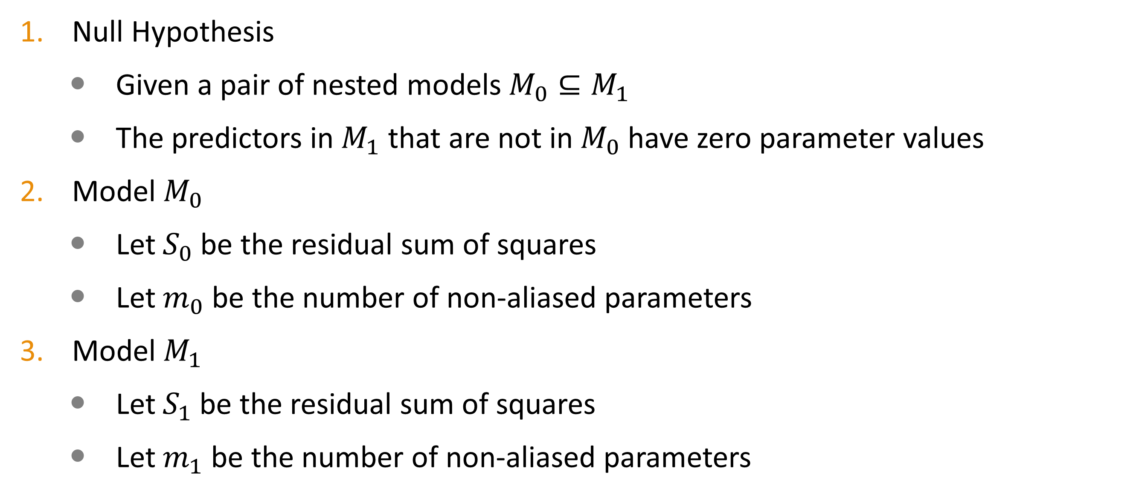
F Test For Nested Models
Null Hypothesis
Given a pair of nested models $M_{0}⊆M_{1}$
The predictors in $M_{1}$ that are not in $M_{0}$ have zero parameter values
Model $M_{0}$
Let $S_{0}$ be the residual sum of squares
Let $m_{0}$ be the number of non-aliased parameters
Model $M_{1}$
Let $S_{1}$ be the residual sum of squares
Let $m_{1}$ be the number of non-aliased parameters

Slide 39
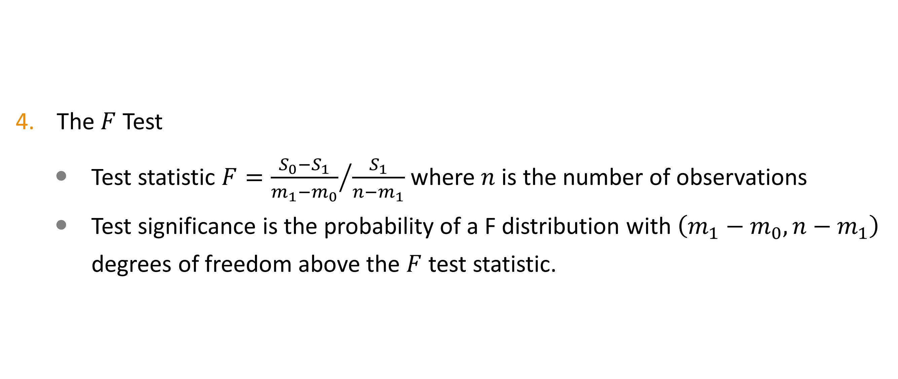
F Test For Nested Models
The $F$ Test
Test statistic $F={\frac{S_{0}−S_{1}}{m_{1}−m_{0}}}/{\frac{S_{1}}{n−m_{1}}}$ where $n$ is the number of observations
Test significance is the probability of a F distribution with $\left(m_{1}−m_{0},n−m_{1}\right)$ degrees of freedom above the $F$ test statistic.

Slide 40
F Test For Nested Model
Is the test significance value less than a pre-specified tolerance threshold (e.g., 0.05)?
We need to retain the additional predictors in $M_{1}$ because they helps improve the goodness-of-fit
We need to retain the additional predictors in 𝑀_1 because they helps improve the goodness-of-fit
We can ignore the additional predictors in $M_{1}$ because dropping them will not hurt the goodness-of-fit
We can ignore the additional predictors in 𝑀_1 because dropping them will not hurt the goodness-of-fit
YES
NO

Slide 41
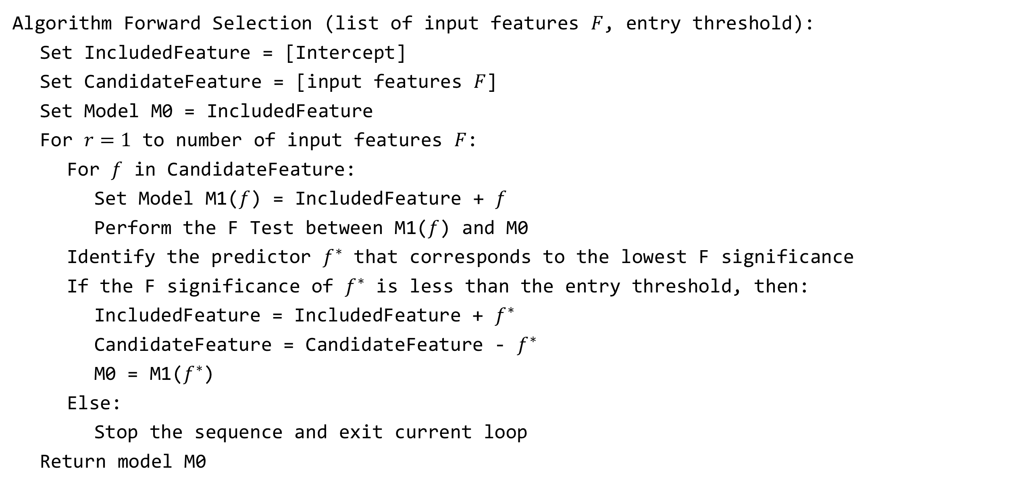
Forward Selection Procedure
Algorithm Forward Selection (list of input features $F$, entry threshold):
Set IncludedFeature = [Intercept]
Set CandidateFeature = [input features $F$]
Set Model M0 = IncludedFeature
For $r=1$ to number of input features $F$:
For $f$ in CandidateFeature:
Set Model M1($f$) = IncludedFeature + $f$
Perform the F Test between M1($f$) and M0
Identify the predictor $f^{∗}$ that corresponds to the lowest F significance
If the F significance of $f^{∗}$ is less than the entry threshold, then:
IncludedFeature = IncludedFeature + $f^{∗}$
CandidateFeature = CandidateFeature - $f^{∗}$
M0 = M1($f^{∗}$)
Else:
Stop the sequence and exit current loop
Return model M0

Slide 42
Regression with a Categorical Feature

Slide 43
See The Data From Another Perspective
Conditional on Trip Minutes and Trip Miles, it seems that the payment is higher if it is paid by Credit Card.

Slide 44
Regression with Categorical Features
Besides Trip_Minutes and Trip_Miles, we will add Payment_Method to the linear regression model.
Since Payment_Method is obviously a categorical predictor, we will generate two dummy variables to represent its two categories.
The pandas.get_dummies() function comes handy to generate the dummy variables. Please see Module 5 Twenty Chicago Taxi Trip.py for sample code.

Slide 45
Regression with Categorical Features
The model matrix contain the following columns
'Intercept',
'Payment_Method_Cash',
'Payment_Method_Credit Card',
'Trip_Minutes', and
'Trip_Miles’
The second and the third columns correspond to the two dummy variables for Payment_Method listed in ascending lexical order of categories.

Slide 46
Forward Selection with Categorical Features
Since we derive the dummy variables Payment_Method_Cash and Payment_Method_Credit Card from the categorical feature Payment_Method, these two dummy variables must enter the model together if Payment_Method is selected.
Similarly, if Payment_Method is not selected, these two dummy variables must also leave the model together.

Slide 47
Forward Selection Step Summary
Step | Predictor | Type | N Parameters | Residual Sum of Squares | F | DF1 | DF2 | Significance
0 | Intercept |  | 1 | 1139.2324
1 | Trip_Miles | interval | 2 | 340.6666 | 42.1943 | 1 | 18 | 4.1498E-06
2 | Payment_Method | categorical | 3 | 28.4608 | 186.4844 | 1 | 17 | 1.3599E-10

Slide 48
Final Model Parameter Estimates
Parameter | Estimate | Standard Error | t | Significance | 95% Confidence Interval | Upper 95 CI
 |  |  |  |  | Lower Limit | Upper Limit
Intercept | 13.6721 | 1.7585 | 7.7747 | 5.37E-07 | 9.9619 | 17.3823
Trip_Miles | 2.1793 | 0.1030 | 21.1649 | 1.18E-13 | 1.9620 | 2.3965
Payment_Method_Cash | -7.9110 | 0.5793 | -13.6559 | 1.36E-10 | -9.1332 | -6.6887
Payment_Method_Credit Card | 0 | 0 | . | . | 0 | 0

Slide 49
=== In-Video Questions For Slide 48 ===
Why the estimate of the parameter Payment_Method_Credit Card is zero?
Suggestions. The parameter Payment_Method_Credit Card is aliased. A common convention is to fix an aliased parameter at zero.

Slide 50
Interpret the Model
The base rate is $13.6721 once the taxi driver starts the meter.
Each mile costs me $2.1793 on average.
The trip payment will be $7.9110 less if I pay Cash.
There is no discount on trip payment if I pay by Credit Card.
Does this solution suggest that a taxi driver will give me a discount on the fare if I pay Cash?

Slide 51
Switch Categories of Payment Method
Since the SWEEP algorithm finds aliased parameters sequentially in the order the parameters are specified, we can make the Cash category aliased by moving it after the Credit Card category.
In doing so, we switch the reference category for Payment_Method from the Credit Card category to the Cash category.
Please see Module 5 Twenty Chicago Taxi Trip.py for implementing this category switch.

Slide 52
Final Model [Reordered] Parameter Estimates
Parameter | Estimate | Standard Error | t | Significance | 95% Confidence Interval | Upper 95 CI
 |  |  |  |  | Lower Limit | Upper Limit
Intercept | 5.7612 | 1.7317 | 3.3269 | 3.9917E-03 | 2.1076 | 9.4148
Trip_Miles | 2.1793 | 0.1030 | 21.1649 | 1.1841E-13 | 1.9620 | 2.3965
Payment_Method_Credit Card | 7.9110 | 0.5793 | 13.6559 | 1.3599E-10 | 6.6887 | 9.1332
Payment_Method_Cash | 0 | 0 |  |  | 0 | 0

Slide 53
Interpret the Model Again
The base rate is $5.7612 once the taxi driver starts the meter.
Each mile costs me $2.1793 on average.
If I pay by credit card, I will pay $7.9110 more.
If I pay cash, I will pay according to the meter.
Unless the driver over-charged me, this solution suggests that I may tip the driver, on average $7.91, if I pay by credit card.

Slide 54
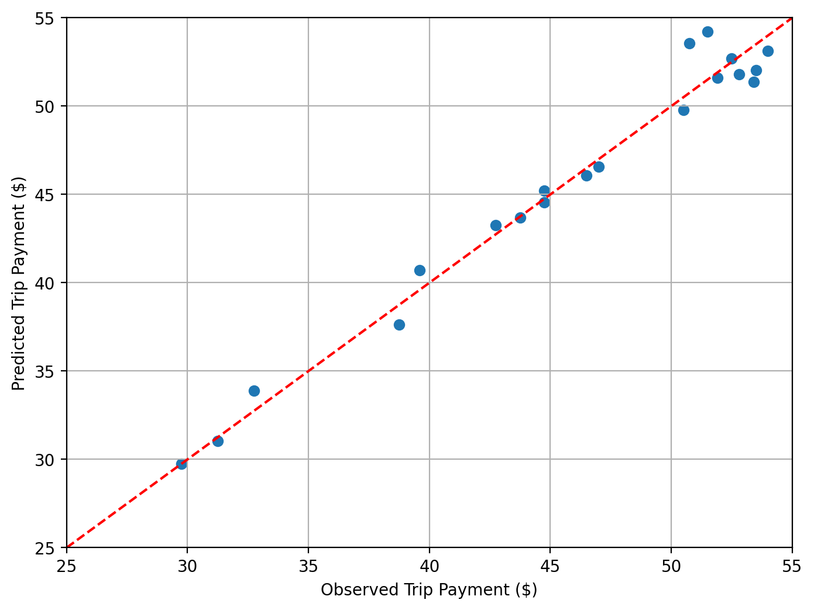
Predicted Versus Observed Response
The red dotted line is a 45-degree reference line.
Markers above (below) the reference line indicate over-(under-) estimated Trip Payment.

Slide 55
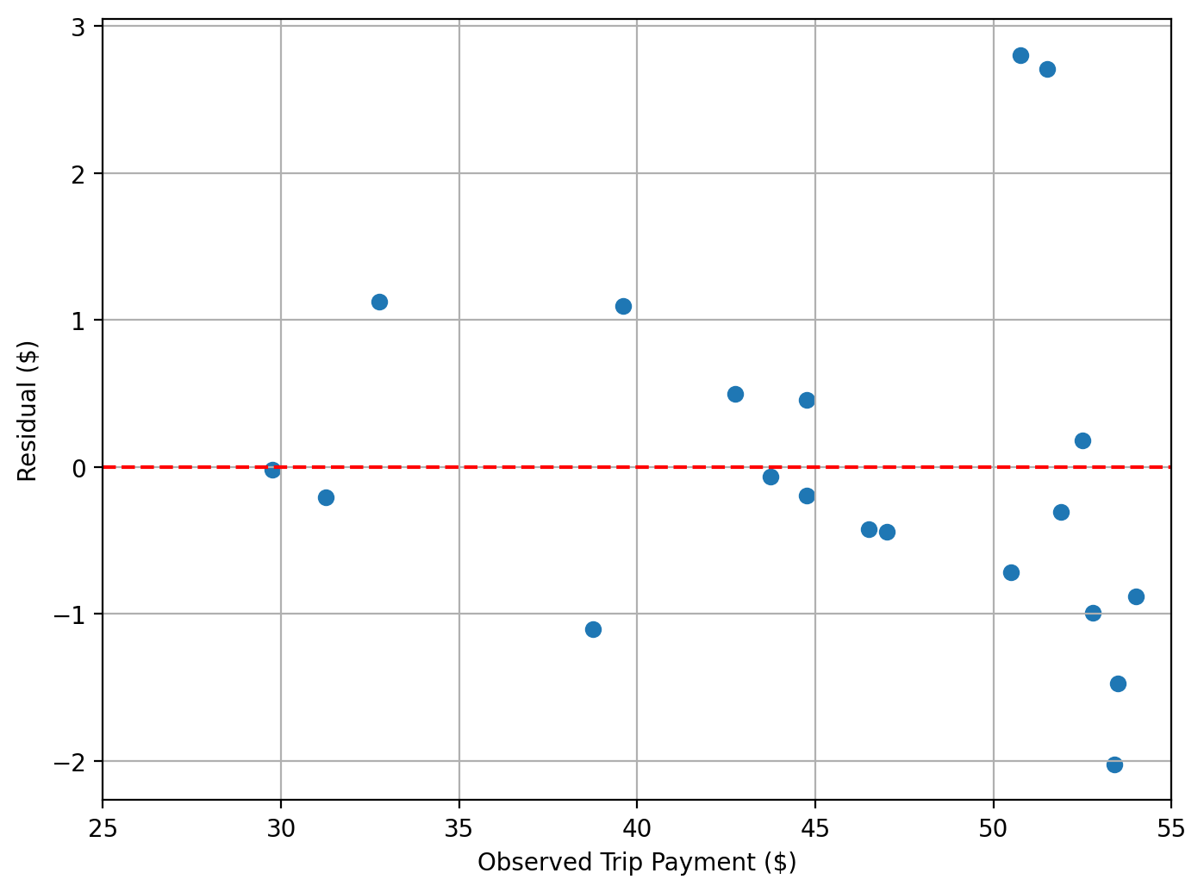
Residual Versus Observed Response
We take note as we anticipate an uneventful chart!
The model assumes the residuals have a normal distribution, so it is unusual (though not impossible) to see residuals that are less than -2 or larger than +2.

Slide 56
END OF LESSON 2

Slide 57
Lesson 3: Feature Importance

Slide 58
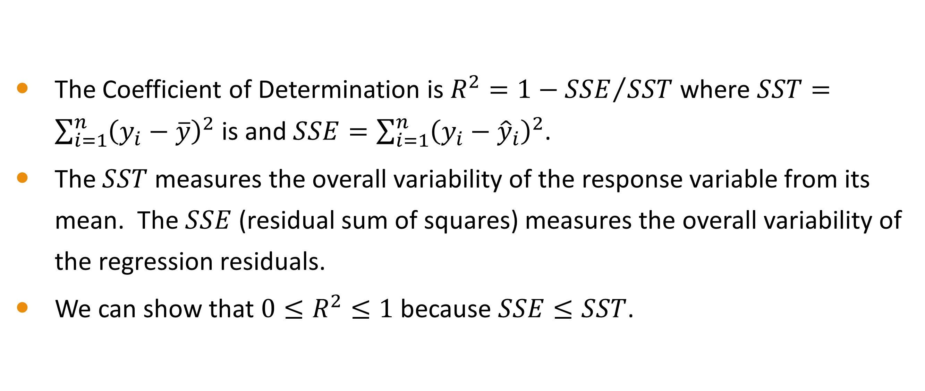
Coefficient of Determination
The Coefficient of Determination is $R^{2}=1−{SSE}/{SST}$ where $SST=\sum_{i=1}^{n}{{\left(y_{i}−\overline{y}\right)}^{2}}$ is and $SSE=\sum_{i=1}^{n}{{\left(y_{i}−{\hat{y}}_{i}\right)}^{2}}$.
The $SST$ measures the overall variability of the response variable from its mean. The $SSE$ (residual sum of squares) measures the overall variability of the regression residuals.
We can show that $0≤R^{2}≤1$ because $SSE≤SST$.

Slide 59
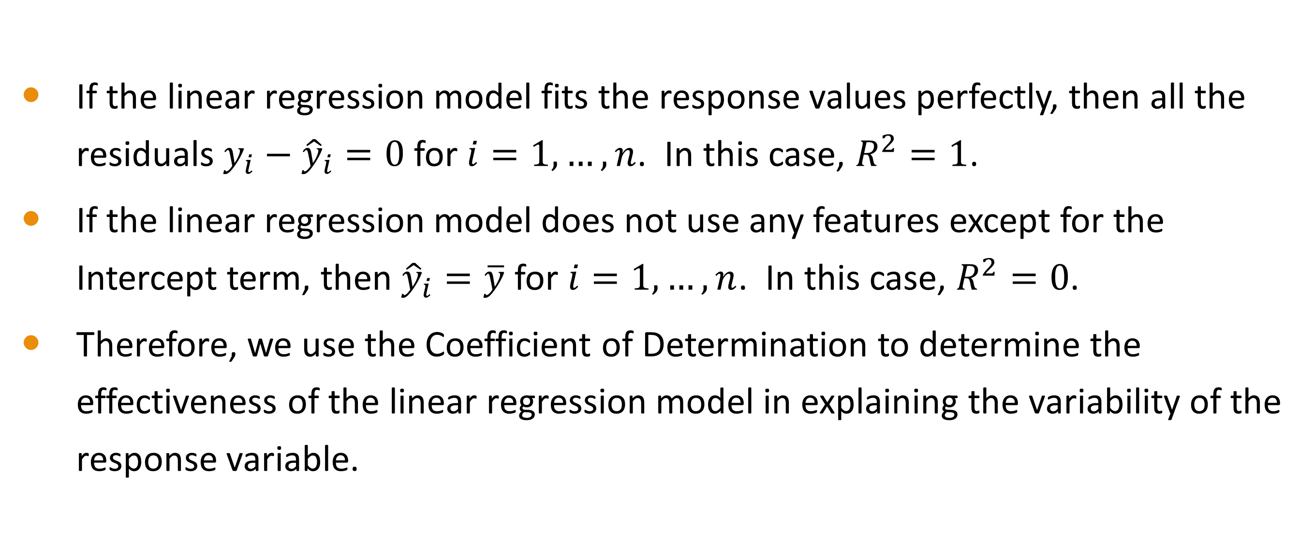
Coefficient of Determination
If the linear regression model fits the response values perfectly, then all the residuals $y_{i}−{\hat{y}}_{i}=0$ for $i=1,…,n$. In this case, $R^{2}=1$.
If the linear regression model does not use any features except for the Intercept term, then ${\hat{y}}_{i}=\overline{y}$ for $i=1,…,n$. In this case, $R^{2}=0$.
Therefore, we use the Coefficient of Determination to determine the effectiveness of the linear regression model in explaining the variability of the response variable.

Slide 60

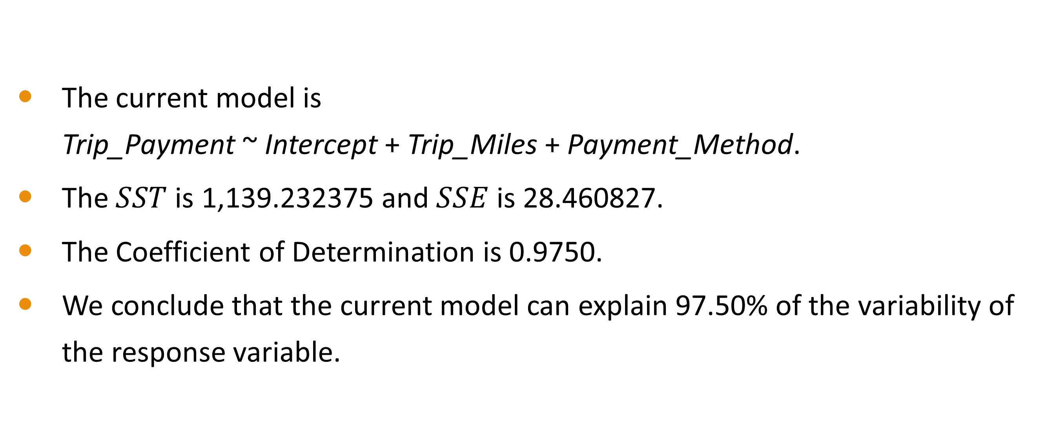
Chicago Taxi Trip
The current model is Trip_Payment ~ Intercept + Trip_Miles + Payment_Method.
The $SST$ is 1,139.232375 and $SSE$ is 28.460827.
The Coefficient of Determination is 0.9750.
We conclude that the current model can explain 97.50% of the variability of the response variable.

Slide 61
=== In-Video Questions For Slide 60 ===
Suppose we add Trip_Minutes to this regression model, what is the Coefficient of Determination of the new model?
Feedback. Adding features to a linear regression model will always increase the Coefficient of Determination. The new model will have a Coefficient of Determination of 0.9794.

Slide 62
The Principle of Parsimony
We have two competing goals for our model.
We want our model to explain as much variability as possible of the response variable. Thus, we push the Coefficient of Determination as high as possible.
We want our model to be easily interpreted and deployed. Hence, we include only the necessary features in the model.

Slide 63
Are All Features Equally Predictive?
The Forward Selection method will only include features that are statistically predictive of the response variable. They together raise the Coefficient of Determination as high as possible.
Because of the correlations among the features, we cannot help but wonder if the selected features are also the most predictive. Are the features excluded not predictive at all? Did we miss out on something else?
How much does each feature contribute to the Coefficient of Determination?

Slide 64
Coalition Game

Slide 65
Game Theory
Game theory is a branch of mathematics
It studies how interacting choices, rational or irrational, of self-interested players (or agents) produce outcomes to the preferences of those players.
Through implementing the optimal strategy, the goal is to generate the highest return (or reduce the loss to a minimum).

Slide 66
Game Theory
Self-Interested Players
Their perceptions of the states of their worlds motivated their choices.
Their only goal is to maximize their benefits in the game.
They must have no intention to harm or eliminate other players.
Choices
The alternatives available in the game.
Each player must make a choice. Abstention is not permitted!

Slide 67
Utility
Utility Value
A numeric value that represents the level of benefit of a preference
Can be positive, zero, or negative
Player-specific i.e., players’ utilities can be different in the same game
Utility Function
A mapping from a preference to a numeric value.
The domain is the collection of the available preferences in a game

Slide 68
Coalitional (or Cooperative) Game
A coalitional game consists of groups of players called coalitions.
A coalitional game is a competition between coalitions of players, rather than between individual players.
Coalitions are the primary units of decision-making.
An empty coalition has no players.
The Grand Coalition consists of all the possible players.

Slide 69
Coalitional (or Cooperative) Game
A coalition will receive a payoff for participating in the game.
The payoff of an empty coalition must be zero.
A coalition with more players will receive a larger payoff.
Each player in a coalition demands a share of the payoff.
How to fairly allocate the payoff of the coalition among the players in the Grand Coalition?

Slide 70
Shapley Value

Slide 71
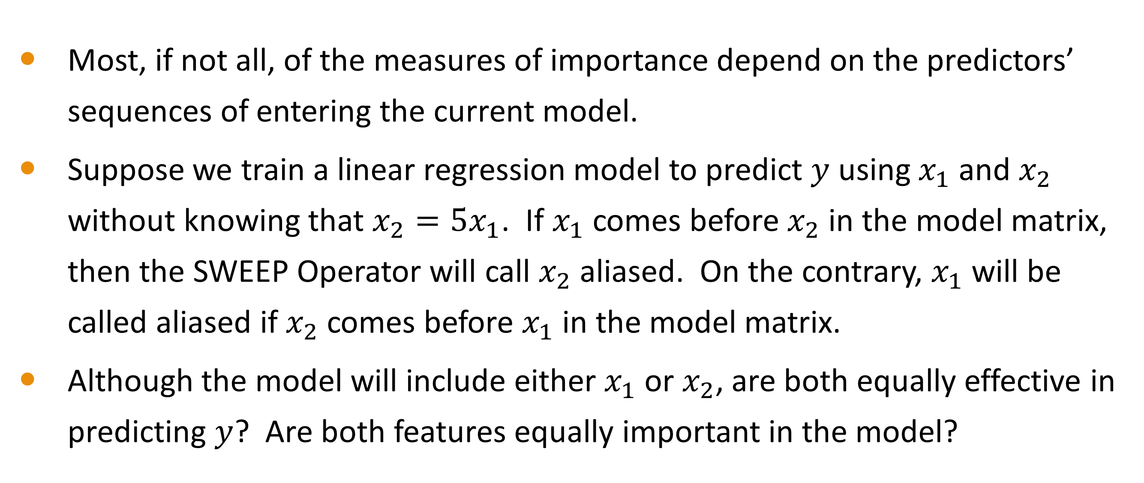
An Absolute Measure of Importance
Most, if not all, of the measures of importance depend on the predictors’ sequences of entering the current model.
Suppose we train a linear regression model to predict $y$ using $x_{1}$ and $x_{2}$ without knowing that $x_{2}=5x_{1}$. If $x_{1}$ comes before $x_{2}$ in the model matrix, then the SWEEP Operator will call $x_{2}$ aliased. On the contrary, $x_{1}$ will be called aliased if $x_{2}$ comes before $x_{1}$ in the model matrix.
Although the model will include either $x_{1}$ or $x_{2}$, are both equally effective in predicting $y$? Are both features equally important in the model?

Slide 72
An Overview of Shapley Value
Shapley values provide us with an absolute measure of importance for all predictors that can be considered for a model.
Shapley values consider all the possible sequences the predictors can enter the model. Each sequence generates one realization of importance, and Shapley values are the average of all realizations.
Even when a candidate does not make it into the model (because of linear dependence), its Shapley value can tell us its importance if the model includes it.

Slide 73
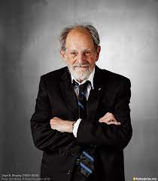
Shapley Value
Dr. Lloyd Stowell Shapley (1923 – 2016)
American, born in Cambridge, Massachusetts
Ph.D. in mathematics from Princeton University in 1953
Awarded jointly with Alvin E. Roth the 2012 Nobel Prize in Economic Sciences for the theory of stable allocations and the practice of market design.
Shapley, Lloyd S. (1953). A Value for N-Person Games. Contributions to the Theory of Games (AM-28), Volume II. Pages 307-317. Princeton University Press.

Slide 74
Calculate Shapley Value
Each player will be equally likely to initiate a coalition
Consider all the possible orders of players can join the coalition
Calculate the marginal value each player contributes to the coalition
Average a player’s marginal contributions over all the possible order
The average value is the Shapley value of that player

Slide 75
Sharing a Taxi Ride
Three students Amy (A), Betty (B), and Cathy (C) share a taxi from Millennium Park in downtown Chicago. They agree to pay their fair share of the taxi fare.
Amy gets off at Water Tower Place, Betty at Lincoln Park Zoo, and Cathy at Wrigley Fields. The final taxi fare is $30, and Cathy pays in full to the taxi driver.
How much Cathy should receive from Amy and Betty?
If Amy rides alone, her taxi fare is $9.
If Betty rides alone, her taxi fare is $18.
If Cathy rides alone, her taxi fare is $30.

Slide 76
Taxi Ride Example
The Grand Coalition consists of three players A, B, and C
The Utility values are:
Singleton: v({A}) = 9, v({B}) = 18, and v({C}) = 30
Two-Players: v({A,B}) = 18, v({A,C}) = 30, v({B,C}) = 30
Three-Players: v({A,B,C}) = 30
There are 3! = 6 sequences to form the Grand Coalition
{A, B, C}, {A, C, B}, {B, A, C}, {B, C, A}, {C, A, B}, and {C, B, A}

Slide 77
Taxi Ride Example
Coalition Formation Sequence | Coalition Utility Value
Coalition Formation Sequence | First Player Joins | Second Player Joins | Third Player Joins
A, B, C | 9 | 18 | 30
A, C, B | 9 | 30 | 30
B, A, C | 18 | 18 | 30
B, C, A | 18 | 30 | 30
C, A, B | 30 | 30 | 30
C, B, A | 30 | 30 | 30

Slide 78
Taxi Ride Example
Coalition Formation Sequence | Coalition Utility Value |  |  | Player Contributes
Coalition Formation Sequence | First Player Joins | Second Player Joins | Third Player Joins | A | B | C
A, B, C | 9 | 18 | 30 | 9 | 18 – 9 = 9 | 30 – 18 = 12
A, C, B | 9 | 30 | 30 | 9 | 30 – 30 = 0 | 30 – 9 = 21
B, A, C | 18 | 18 | 30 | 18 - 18 = 0 | 18 | 30 – 18 = 12
B, C, A | 18 | 30 | 30 | 30 – 30 = 0 | 18 | 30 – 18 = 12
C, A, B | 30 | 30 | 30 | 30 – 30 = 0 | 30 – 30 = 0 | 30
C, B, A | 30 | 30 | 30 | 30 – 30 = 0 | 30 – 30 = 0 | 30
Average Contribution |  |  |  | 18/6 = 3 | 45/6 = 7.5 | 117/6 = 19.5
Sum of Average Contributions is 3 + 7.5 + 19.5 = 30

Slide 79
=== In-Video Questions For Slide 78 ===
Since Amy, Betty, and Cathy ride together between Millennium Park and Water Tower Place, they equally share the fare for the first leg of the trip. The fare for this leg is $9, so each is liable for $3.
After Amy got off at Water Tower Place, Betty and Cathy rode together until Lincoln Park Zoo. How much should Betty and Cathy pay for the second leg of the trip? Finally, how much Cathy should pay for the final leg of the trip?
Feedback. The second leg of the trip cost $18 - $9 = $9. Equally divided between Betty and Cathy, each pays $4.5. This means Betty has paid $3 + $4.5 = $7.5.

Slide 80
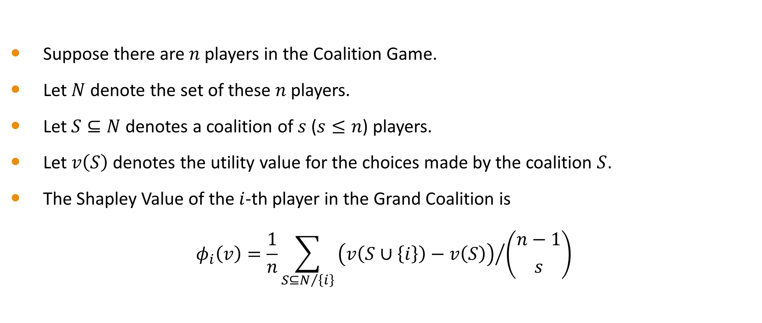
Shapley Value
Suppose there are $n$ players in the Coalition Game.
Let $N$ denote the set of these $n$ players.
Let $S⊆N$ denotes a coalition of $s$ ($s≤n$) players.
Let $v\left(S\right)$ denotes the utility value for the choices made by the coalition $S$.
The Shapley Value of the $i$-th player in the Grand Coalition is
$$φ_{i}\left(v\right)=\frac{1}{n}\sum_{S⊆N/{\left\{i\right\}}}{{\left(v\left(S∪\left\{i\right\}\right)−v\left(S\right)\right)}/{\left({n−1 \atop s}\right)}}$$

Slide 81
A Linear Regression as a Coalitional Game
The Grand Coalition consists of all the features being considered.
A coalition is a subset of features.
The coalitions will compete to be included in a regression model
The playoff is the Coefficient of Determination. The more features in the model, the higher the Coefficient of Determination.
The importance of a feature is the fair share of the Grand Coalition’s playoff that the feature is entitled to.

Slide 82
Twenty Chicago Taxi Trips

Slide 83
Twenty Chicago Taxi Trips
Module 5 Chicago Taxi Shapley Value.py

Slide 84
All Possible Subset Regression
Index | Model | Coefficient of Determination
000 | Intercept | 0.0
100 | Intercept + Payment_Method | 0.3167265
010 | Intercept + Trip_Minutes | 0.0967198
001 | Intercept + Trip_Miles | 0.7009683
110 | Intercept + Payment_Method + Trip_Minutes | 0.3917907
101 | Intercept + Payment_Method + Trip_Miles | 0.9750175
011 | Intercept + Trip_Minutes + Trip_Miles | 0.7101373
111 | Intercept + Payment_Method + Trip_Minutes + Trip_Miles | 0.9794143

Slide 85
The Grand Coalition
Coalition | Feature 1 | Feature 2 | Feature 3
(Payment_Method, Trip_Minutes, Trip_Miles) | 0.3167265 | 0.3917907 | 0.9794143
(Payment_Method, Trip_Miles, Trip_Minutes) | 0.3167265 | 0.9750175 | 0.9794143
(Trip_Minutes, Payment_Method, Trip_Miles) | 0.0967198 | 0.3917907 | 0.9794143
(Trip_Minutes, Trip_Miles, Payment_Method) | 0.0967198 | 0.7101373 | 0.9794143
(Trip_Miles, Payment_Method, Trip_Minutes) | 0.7009683 | 0.9750175 | 0.9794143
(Trip_Miles, Trip_Minutes, Payment_Method) | 0.7009683 | 0.7101373 | 0.9794143

Slide 86
(Trip_Minutes, Payment_Method, Trip_Miles) Coalition
Coalition | Feature 1 | Feature 2 | Feature 3
(Trip_Minutes, Payment_Method, Trip_Miles) | 0.0967198 | 0.3917907 | 0.9794143
At the beginning, the coalition utility value is zero.
Trip_Minutes initiates the coalition, so it contributes 0.0967198 - 0 = 0.0967198 to the coalition utility value.
Payment_Method joins the coalition next, and it contributes 0.3917907 - 0.0967198 = 0.2950709 to the coalition utility value.
Trip_Miles joins the coalition last, and it contributes 0.9794143 - 0.3917907 = 0.5876236 to the coalition utility value.

Slide 87
Feature’s Contribution to Coef. of Determination
Coalition | Payment_Method | Trip_Mintutes | Trip_Miles
(Payment_Method, Trip_Minutes, Trip_Miles) | 0.3167265 | 0.0750641 | 0.5876236
(Payment_Method, Trip_Miles, Trip_Minutes) | 0.3167265 | 0.0043967 | 0.6582910
(Trip_Minutes, Payment_Method, Trip_Miles) | 0.2950709 | 0.0967198 | 0.5876236
(Trip_Minutes, Trip_Miles, Payment_Method) | 0.2692769 | 0.0967198 | 0.6134175
(Trip_Miles, Payment_Method, Trip_Minutes) | 0.2740493 | 0.0043967 | 0.7009683
(Trip_Miles, Trip_Minutes, Payment_Method) | 0.2692769 | 0.0091691 | 0.7009683
Average Contribution | 0.2901878 | 0.0477444 | 0.6414820
Take note! The sum of Average Contributions is 0.2901878 + 0.0477444 + 0.6414820 = 0.9794143. The sum is equal to the Coefficient of Determination of the model Intercept + Payment_Method + Trip_Minutes + Trip_Miles.

Slide 88
The Regression Shapley Values
Feature | Shapley Value | Percent Shapley
Payment_Method | 0.2901878 | 29.63%
Trip_Mintutes | 0.0477444 | 4.87%
Trip_Miles | 0.6414820 | 65.50%
Sum | 0.9794143 | 100%

Slide 89
Feature Importance
When we use Payment_Method, Trip_Minutes, and Trip_Miles as features in a linear regression to predict Trip_Payment, the Coefficient of Determination of this model is 0.9794.
This means the linear regression explains 97.94% of the variability of Trip_Payment. We can break down this percentage by features.
Trip_Miles explains 64.15% of the variability of Trip_Payment.
Payment_Method explains 29.02% of the variability of Trip_Payment.
Trip_Minutes explains the remaining 4.77% of the variability of Trip_Payment.

Slide 90
END OF LESSON 3

Slide 91
END OF MODULE 5

